Slide 1
XMC4500 USB Host Virtual COM Port (VCOM) Example
Getting Started V1.0

Slide 2
Contents
1
Overview
2
Requirements
3
Setup
4
Implementing the application
5
How to test
6
Debug hints
7
Further reading
8
Limitations

Slide 3
Contents
1
Overview
2
Requirements
3
Setup
4
Implementing the application
5
How to test
6
Debug hints
7
Further reading
8
Limitations

Slide 4
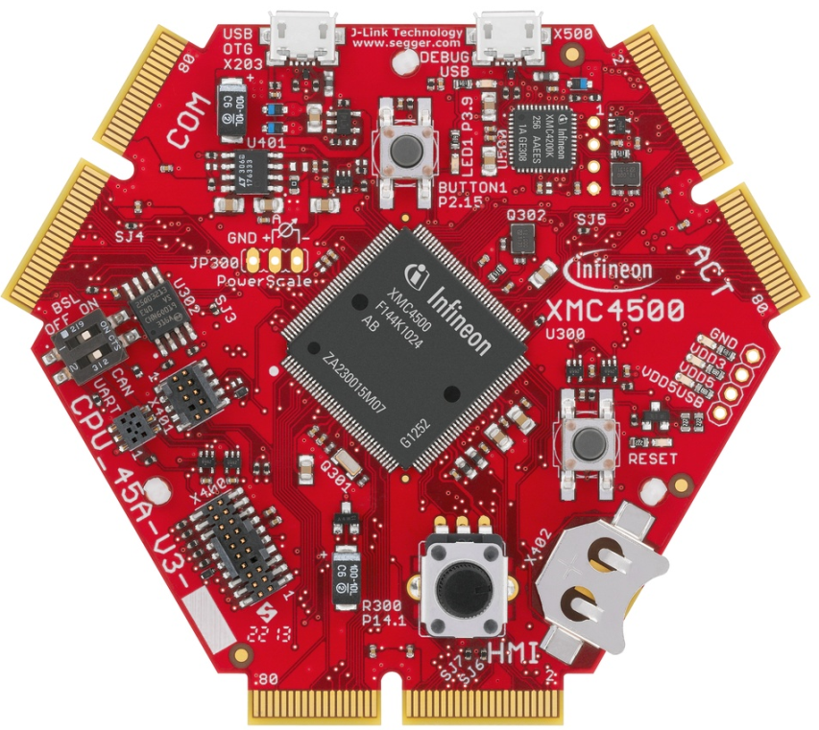
Overview
This example demonstrates the implementation of USB host virtual COM (VCOM) port functionality. It is based on the free LUFA USB host stack implementation which is ported to XMC4500 family and provided within this example.
Within this documentation you will be guided through all the building blocks of a typical USB host VCOM application on the XMC4500 family. You will be able to connect a VCOM device to the host and perform data transfers access to and from the device.
As a result you will be enabled to implement your own USB host VCOM functionality on the XMC4500 family.

Slide 5
Contents
1
Overview
2
Requirements
3
Setup
4
Implementing the application
5
How to test
6
Debug hints
7
Further reading
8
Limitations

Slide 6

Requirements - hardware
Two XMC4500 General Purpose CPU_45A-V3 boards
One will behave as a USB host and another will behave as a USB device
USB cable micro-A plug to micro-B plug for host example
USB cable micro-B plug to standard-A plug for debugging and serial port terminal
Micro-A plug
Micro-B plug
Micro-B plug
Std-A plug

Slide 7
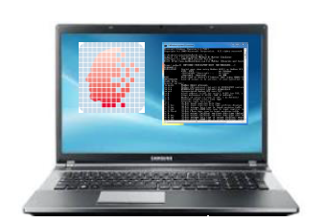

Requirements – hardware and software
Windows laptop
DAVETM installed
DAVE TM (v4.1.4 or Higher)
Download DAVETM free of charge
Link : DAVETM 4 Download
Download USB device VCOM app from DAVETM
Serial port terminal software like Tera Term
Link : http://ttssh2.osdn.jp/

Slide 8
Requirements – free software download
DAVE TM (v4.1.4 or Higher)
Download DAVETM
Link : DAVETM 4 Download
Download USB device VCOM app from DAVETM
Serial port terminal software like Tera Term
Link : http://ttssh2.osdn.jp/

Slide 9
Contents
1
Overview
2
Requirements
3
Setup
4
Implementing the application
5
How to test
6
Debug hints
7
Further reading
8
Limitations

Slide 10

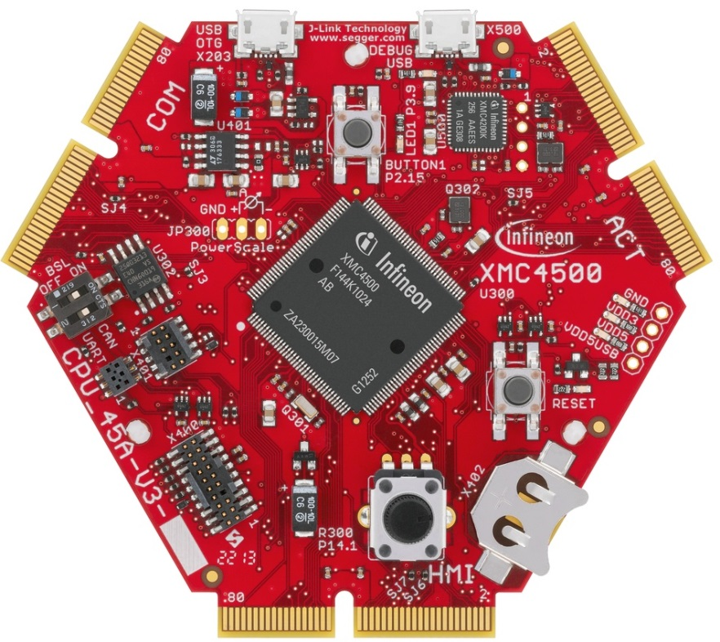
Setup - hardware
XMC4500
USB host
XMC4500
USB device
Micro-A plug
Micro-B plug
Micro-B plug
Windows laptop running DAVETM and serial communication terminal
Std-A plug
Ensure proper cable types
Connect cables to the correct ports

Slide 11
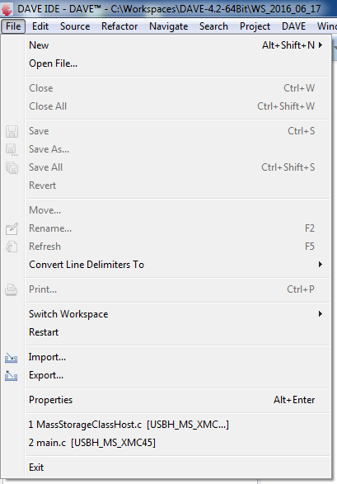
Setup – import VCOM example project in to DAVETM
1

Slide 12
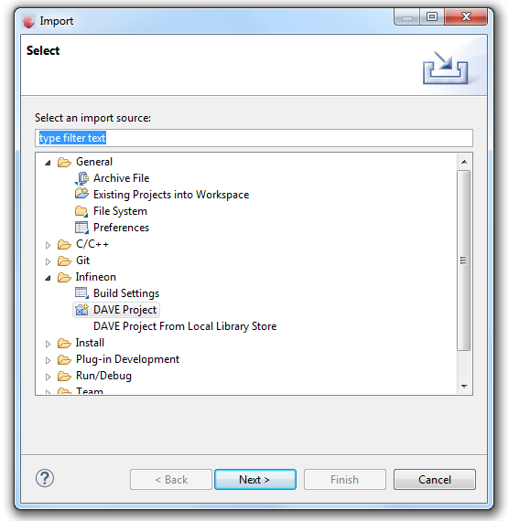
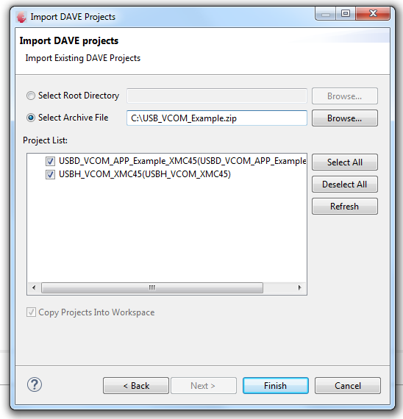
Setup – import VCOM example project in to DAVETM
2
3

Slide 13
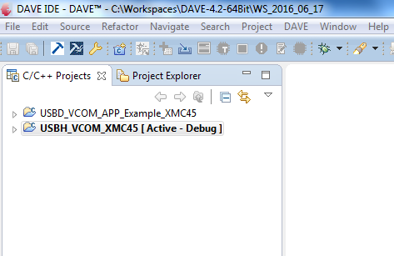
Setup –import VCOM example project in to DAVETM
1
USB VCOM Device project
1
2
USB VCOM Host project
2

Slide 14
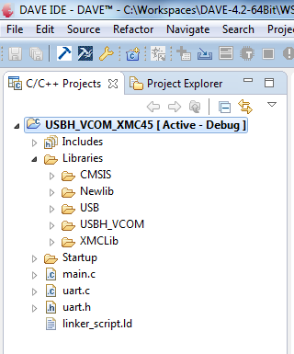
Setup – import VCOM example project in to DAVETM
Check the folder structure of the imported project.
1
VCOM application code implementing USB data transmit and receive
2
The main file implementing the application task and echo data on UART
1
3
3
Free LUFA USB stack, CDC-ACM class and glue layer for XMC low level driver
4
4
XMCLib folder contains USB low level driver in file xmc_usb.c
2
5
5
Code for redirecting data to UART

Slide 15
Contents
1
Overview
2
Requirements
3
Setup
4
Implementing the application
5
How to test
6
Debug hints
7
Further reading
8
Limitations

Slide 16
Example application behavior
First XMC4500 CPU_45A-V3 board is initialized as a USB host and provides VBUS on the USB port. This board runs host VCOM software.
Second XMC4500 CPU_45A-V3 board is initialized as USB device. This board runs VCOM device software.
When successfully enumerated, USB host recognizes the connected device as a CDC-ACM capable device (VCOM)
First XMC4500 as USB host receives data from Windows laptop running serial terminal software like Tera Term and sends data to the device XMC4500 over USB
Second XMC4500 as USB device loops back the received data on the USB
First XMC4500 as USB host redirects received loop back data to debug port connected to Windows laptop running serial terminal software like Tera Term

Slide 17
Simplified example application architecture
Application software
CDC_ACM send, receive data and notification interface
CDC-ACM
Bulk and interrupt pipe APIs
Host core stack
Low level driver based on USB host CMSIS API
USB host low level driver (XMCLib)
USB controller
USB stack and CDC-ACM sub-class implementation is based on a freely available stack known as LUFA

Slide 18
Example application data flow
Application software transfers byte received over UART to the CDC-ACM layer using send and receive APIs
Application software
CDC-ACM layer transfers the data to the host core stack. It also prepares to receive any notification messages on the interrupt endpoint
CDC-ACM
Host stack manages connections and enumeration. Provides mechanisms to transfers data through pipes
Host core stack
USB host low level driver (XMCLib)
Low level driver based on USB host CMSIS API
USB controller

Slide 19
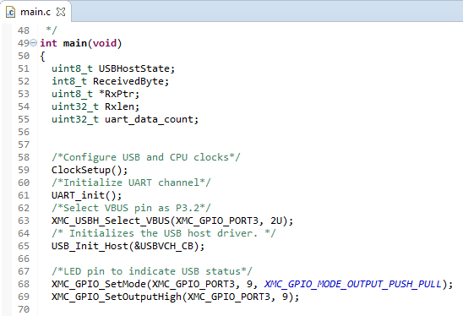
Application – overview of main.c
1
Clock setup for XMC4500
2
Select VBUS pin P3.2
1
3
2
Initialize USB host
3

Slide 20
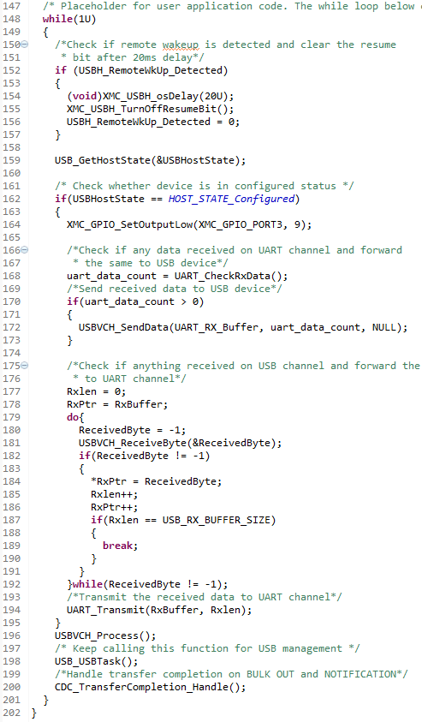
Application – overview of main.c
4
Receive data from UART and send to USB
5
Receive data from USB and send to UART
4
Fetch descriptors and match it to CDC-ACM sub-class and start notification pipe and bulk IN pipe
6
5
7
Manage connection events and initiate enumeration
6
8
Manage transfer completion events
7
8

Slide 21
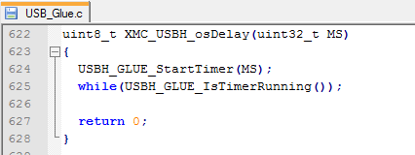
Application – configure time delay API
The USB stack uses timing delay of the order of several tens of milliseconds to comply with the specification
Port the time delay API if required. In the example code, SysTick timer is used
Ensure timer is calibrated

Slide 22
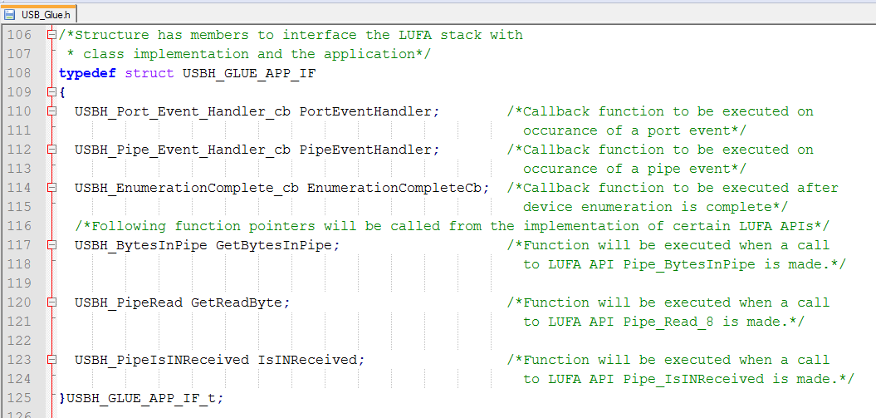
Application - callbacks
Application registers for the following event callbacks

Slide 23
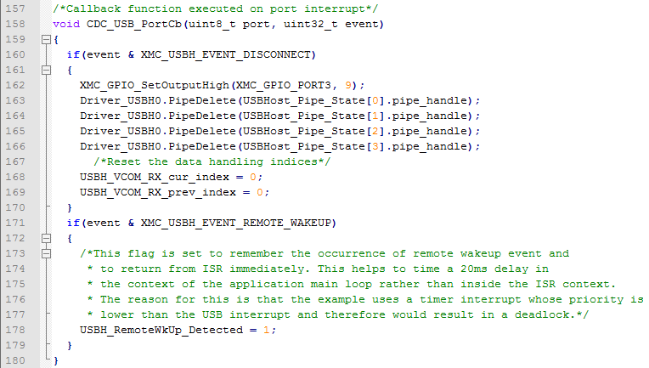
Application – Implement and register required callbacks
1
Implement call back function
1

Slide 24
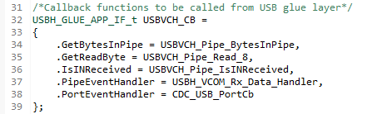
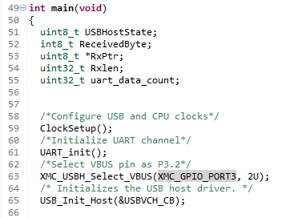
Application – Implement and register required callbacks
2
Register call back function
2
3
Call initialization function
3

Slide 25
Contents
1
Overview
2
Requirements
3
Setup
4
Implementing the application
5
How to test
6
Debug hints
7
Further reading
8
Limitations

Slide 26
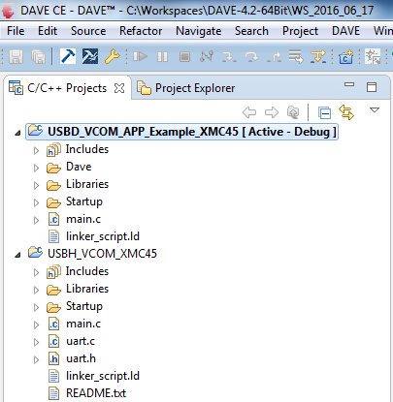
How to test – build and download device project
1
1
Make the device project ‘Active’ and build device project
2
Download image into second XMC4500 General Purpose board. Image now resides in flash memory
3
Reset XMC4500 General Purpose board to start executing the image
2

Slide 27
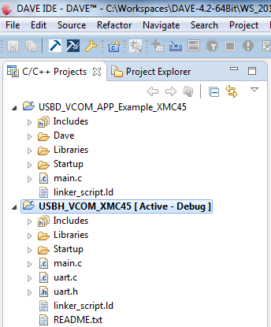
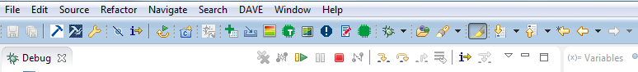
How to test – build and download host project
1
1
Make the host project ‘Active’, build and download host project into first General Purpose board.
2
Start debugger
3
Start the execution by pressing the run button
2
3

Slide 28
How to test
1
Connect the USB cable between the host and device XMC4500 General Purpose boards. Refer slide 10
2
Open serial port terminal software on Windows laptop (example Tera Term)
See next slide on how to locate associated COM port
3
Configure the terminal software for 19200 baud rate, 8 bit data, 1 stop bit, no parity
4
Type some characters. The typed characters will be looped back and visible on the terminal.

Slide 29
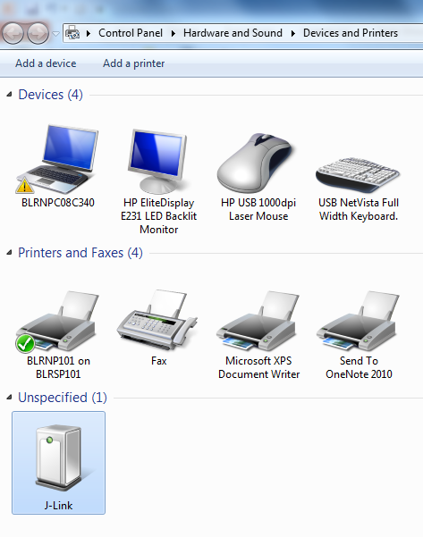
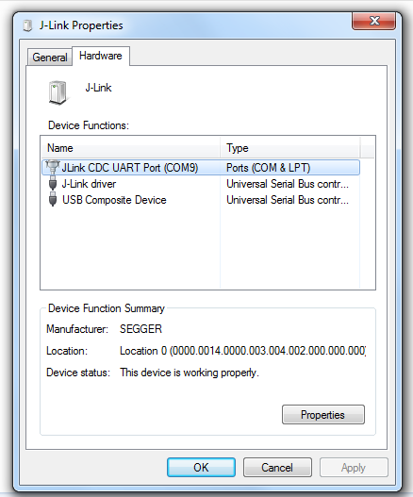
Finding associated COM port on Windows
1
1
Open Control Panel -> Hardware and Sound -> Devices and Printers
2
Right click on J-Link and select Properties, then select Hardware tab. COM port is indicated.
2

Slide 30
Supported features
ACM Requests – SetControlLineState, SetLineCoding, SendBreak
Only ACM Notification - Serial State is implemented

Slide 31
Contents
1
Overview
2
Requirements
3
Setup
4
Implementing the application
5
How to test
6
Debug hints
7
Further reading
8
Limitations

Slide 32
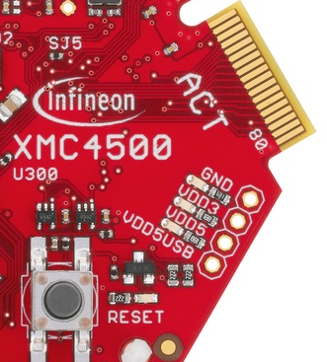
Debug Hints
Check VBUS is available and within permissible range (4.4V to 5.25V) on the USB host port receptacle. Lower VBUS voltages due to excessive current draw may cause USB devices to disconnect intermittently or fail enumeration. Try connecting a different USB device.
Long cables may cause malfunction due to signal quality issues. Use short cables if possible.
Check if XMC4500 VCOM device example application is running properly by connecting device to a Windows host running Tera Term. XMC4500 device will loop back characters typed on terminal.
Test Point

Slide 33
Contents
1
Overview
2
Requirements
3
Setup
4
Implementing the application
5
How to test
6
Debug hints
7
Further reading
8
Limitations

Slide 34
Further reading
USB specifications and Micro-USB cables and connectors specification
http://www.usb.org/developers/docs/usb20_docs/
Communication devices class specifications
Class definitions for communication devices v1.2
Communications class, subclass specifications for PSTN devices
http://www.usb.org/developers/docs/devclass_docs/
CMSIS USB host API specification
https://www.keil.com/pack/doc/CMSIS/Driver/html/group__usb__interface__gr.html

Slide 35
Further reading
LUFA USB stack
http://www.fourwalledcubicle.com/index.php
Books
USB Complete: The Developer's Guide, Jan Axelson
USB Embedded Hosts, Jan Axelson

Slide 36
Contents
1
Overview
2
Requirements
3
Setup
4
Implementing the application
5
How to test
6
Debug hints
7
Further reading
8
Limitations

Slide 37
Limitations
Hubs are not supported
Over current protection is not supported
DMA Transfers are not supported
Low level driver does not support isochronous transfers

